Slide 1
CSA LAB
Assembly Language

Slide 2
Types of Registers (based on hardware)
General Purpose Register
Special Purpose Register
Flag Register
Segment Register

Slide 3
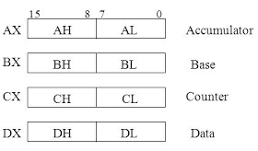
General Purpose Register (GPR)
The register stores intermediate results during program execution.
Can be accessed via assembly programming.
Four different 16 bit-GPRs:
AX
BX
CX
DX

Slide 4
Special Purpose Registers (SPRs)
Users can’t access the SPRs directly
Used by computer system
The SPRs are also known as index or pointer registers
In 8086 Microprocessor, they usually store the offset through which the actual address is calculated.
Offset addresses are those addresses which are added to the current address to get final address.

Slide 5
SPRs
There are five different types of SPRs:
IP (Instruction Pointer): Stores the address of the next instruction that is to be executed.
BP (Base Pointer): stores the base address of the memory
Stack Pointer (SP): Points at the current top value of the Stack
Source Index (SI): Stores the offset address of the source
Destination Index (DI): Stores the offset address of the destination

Slide 6
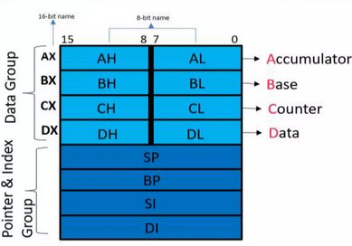
Stack representation of GPRs and SPRs (8086)

Slide 7
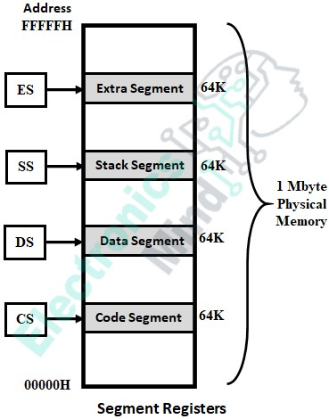
Segment Registers
The 8086 microprocessor has a
20-bit wide physical address to
access 1MB memory location.
But the registers of the 8086
microprocessor that holds the logical
address are only 16-bits wide.
Segmentation is nothing but the division of physical
memory into different segments of logical memory.

Slide 8
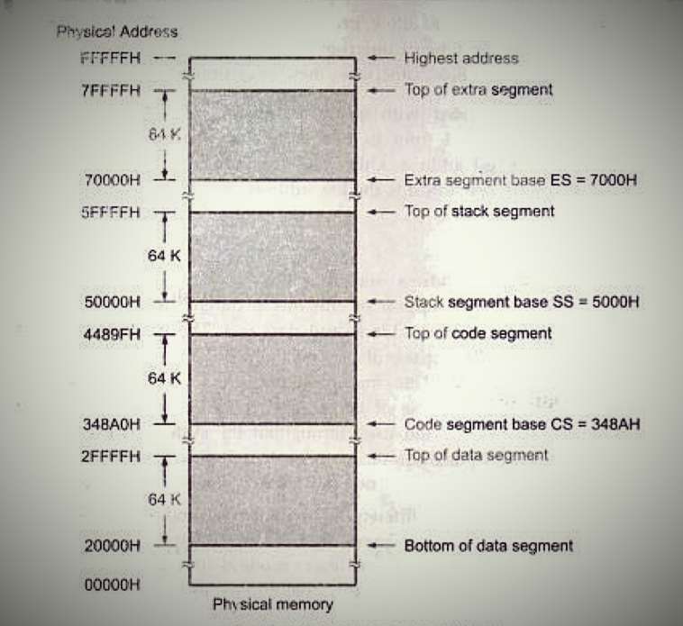
Segment Registers

Slide 9
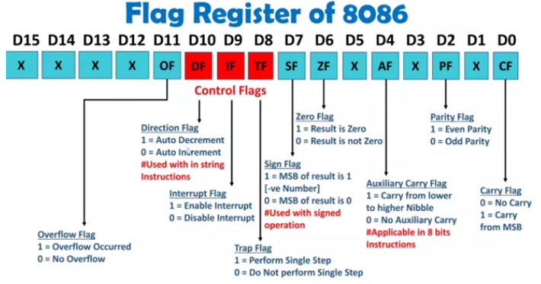
Flag Register

Slide 10
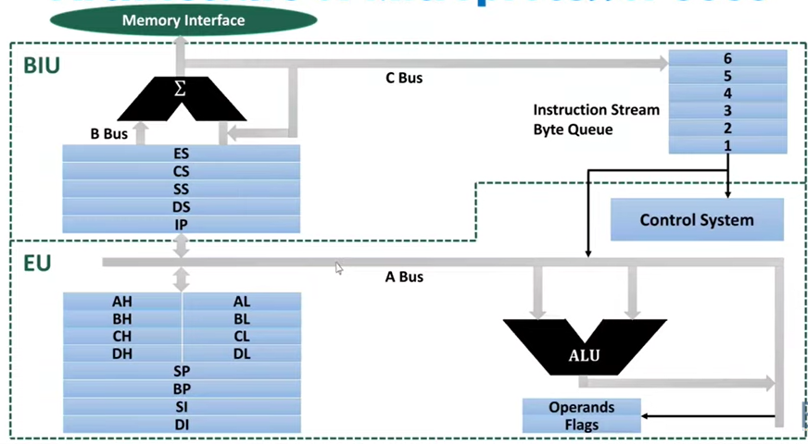
Architecture of 8086 microprocessor

Slide 11
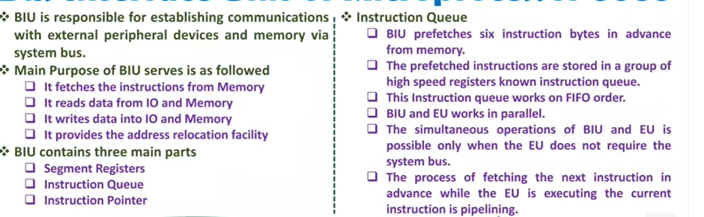
BIU

Slide 12
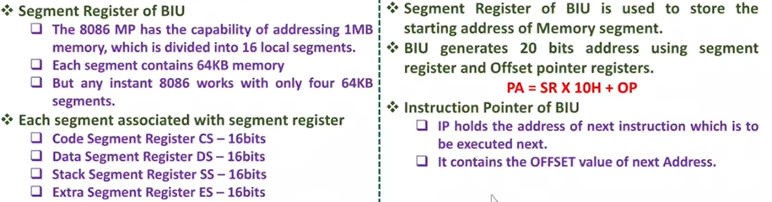
BIU (Bus Interface Unit)

Slide 13
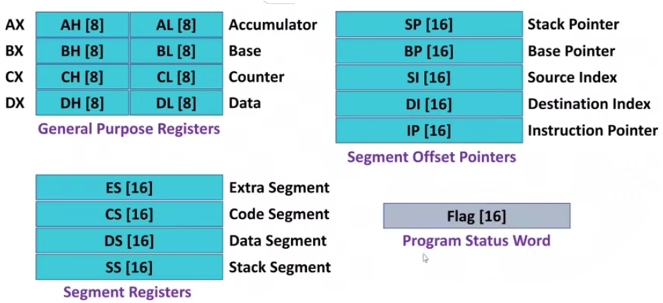
Summary of different registers

Slide 14
Other Registers
Memory Address Register (MAR): Registers that holds the address for memory unit.
Memory Buffer Register (MBR): stores instruction and data “to and fro” the memory.
Data Register (DR): contains 16 bits which hold the operand value, read from the memory location.
Program Counter (PC): points to the next instruction to be executed.
Instruction Register (IR): holds the current instruction to be executed.

Slide 15
Programming

Slide 16
Programming Tools
Assembly language programs are based on the types of microprocessors
Assembly language programs differ with the types of microprocessor

Slide 17
Programming Tools (w.r.t 8086 microprocessor)
Programming tools are divided into two types:
Emulator (DOSBox, Emu8086, PCspim)
Assembler:
TASM (Turbo Assembler)
MASM (Microsoft Macro Assembler)
NASM (Netwide Assembler)
Debugger (DEBUG.EXE, Turbo Debugger)

Slide 18
Installation Guide
Copy TASM folder in c drive (from the folder Installation of DOSBOX)
Install DOSBox (from net)
Note: You can change TASM folder name to any other short name.

Slide 19

DOSBox
We will use DOSBox as 8086 emulator
Initial codes needs to be written everytime
you open DOSBox:
mount c c:\TASM (mount c c:\folder name)
c:
edit
Write your program
Note:
Alt+Enter is used to make the
Editor window full screen
ctrl+F10 (to gain cursor back)
ALT+F to open save and quit bar
Step by step execution : press ALT+R, then traceinto

Slide 20
Save, Debug and Execute
Save your program as EXP_0_AD.ASM (filename.ASM)
Exit to the DOS window or press ALT+F
Write down the following DOS commands:
TASM EXP_0_AD.ASM (filename.ASM; assemble your .asm file to object file )
TLINK EXP_0_AD.OBJ (filename.OBJ; link object file with other object file/libraries)
TD EXP_0_AD.EXE (filename.EXE; compiled file; you can run the compiled file)
After executing,
Press ALT+F
Then save your program
Quit (ALT+X)

Slide 21
First Program
DATA SEGMENT
X DB 5H
Y DB 6H
DATA ENDS
CODE SEGMENT
ASSUME CS: CODE, DS: DATA
START: MOV AX, DATA
MOV DS,AX
MOV AL,X
MOV BL,Y
ADD AL,BL
INT 3H
CODE ENDS
END START

Slide 22
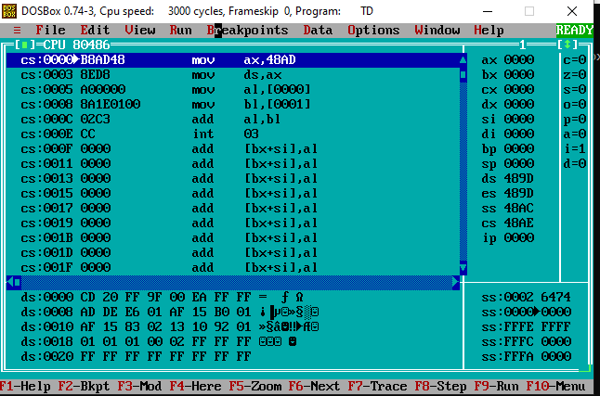
First screen

Slide 23
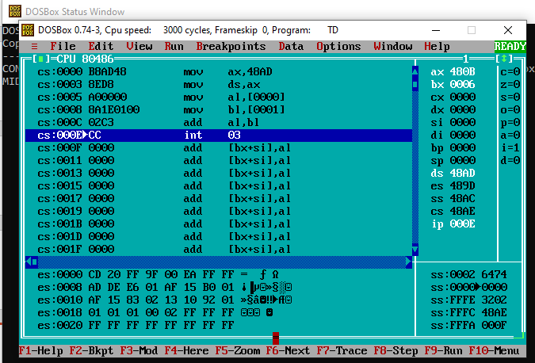
After pressing “run”

Slide 24
For MASM Environment
Download MASM from:
https://programologysofts.blogspot.com/search?q=MASM

Slide 25
PRE & POST PROGRAM INSTRUCTIONS
Pre-program instructions: same as that in TASM
Post program instructions:
MASM FILENAME.ASM
LINK FILENAME.OBJ
FILENAME.EXE

